Slide 1


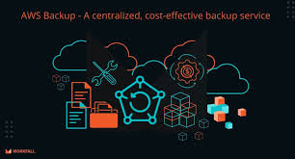
SAVEETHA SCHOOL OF ENGINEERING
SAVEETHA INSTITUTE OF MEDICAL AND TECHNICAL SCIENCES
COURSE CODE:
CSA1580 CLOUD COMPUTING FOR BIG DATA ANLYTICS FOR CLOUD API
TOPIC:
Project on Developing a Secure Backup and Recovery Solution for iCloud Data on AWS
FACULTY NAME:Dr.Gnana Soundari
By,
Aiswariya R
192210483

Slide 2
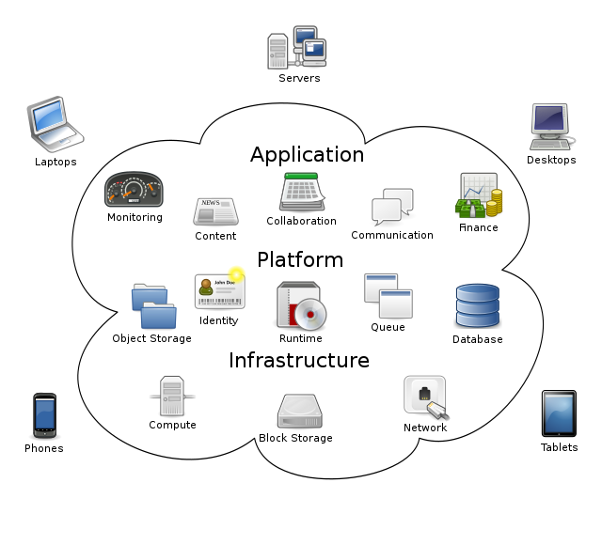
INTRODUCTION
Introduction to the Project: Developing a secure backup and recovery solution for iCloud data hosted on Amazon Web Services (AWS) is crucial to ensure data integrity, availability, and security for millions of iCloud users worldwide.
Importance of Data Protection: With the increasing reliance on cloud services like iCloud for storing personal and business-critical data, the need for robust backup and recovery solutions has become paramount. This project aims to address these needs effectively.
Collaboration Between Apple and AWS: The collaboration between Apple, the provider of iCloud services, and AWS, a leading cloud infrastructure provider, underscores the significance of this project. It leverages AWS's scalable infrastructure and Apple's commitment to data security.
Security Challenges and Solutions: Protecting sensitive iCloud data requires implementing advanced security measures such as encryption, access controls, and data masking. This project focuses on developing and implementing these solutions to mitigate potential risks.
Project Objectives: The primary objective of this project is to design, implement, and deploy a secure backup and recovery solution on AWS that meets Apple's stringent security standards and regulatory requirements while ensuring seamless user experience during data loss scenarios.

Slide 3
FEATURES:
Encryption at Rest and in Transit: Implementing strong encryption mechanisms to ensure data security both when stored in AWS services like S3 (at rest) and during transmission between iCloud and AWS (in transit). This feature ensures that sensitive iCloud data remains protected from unauthorized access.
Automated Backup and Recovery: Designing automated processes for regular backups of iCloud data to AWS, ensuring that data is consistently backed up without manual intervention. Similarly, automated recovery processes enable swift restoration of data in case of data loss or corruption incidents.
Scalable Storage Infrastructure: Leveraging AWS's scalable storage solutions such as Amazon S3 to accommodate the growing volume of iCloud data. This feature ensures that the backup solution can scale seamlessly as the data storage requirements increase over time.
Compliance and Data Governance: Incorporating features to ensure compliance with data protection regulations (e.g., GDPR, CCPA) and Apple's privacy standards. Implementing robust access controls, audit trails, and data governance policies to manage and protect iCloud data stored on AWS effectively.
Monitoring and Alerting: Implementing proactive monitoring tools and alerting mechanisms to track the health and performance of the backup and recovery solution. This feature helps in identifying and addressing any issues promptly, ensuring high availability and reliability of the service.

Slide 4
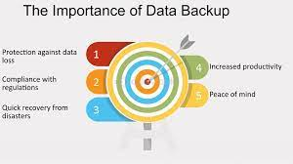
ABSTRACT
Project Overview: This project aims to design and implement a robust backup and recovery solution for iCloud data leveraging Amazon Web Services (AWS) infrastructure. The solution focuses on ensuring data integrity, availability, and security while adhering to Apple's stringent privacy standards.
Key Challenges Addressed: The primary challenges include securing sensitive iCloud data during backup and transmission, implementing efficient recovery processes to minimize downtime, and ensuring compliance with global data protection regulations such as GDPR and CCPA.
Proposed Solution: The proposed solution includes implementing strong encryption protocols for data at rest and in transit, utilizing AWS services like S3 for scalable storage, and designing automated backup schedules and recovery mechanisms to enhance operational efficiency and reliability.
Expected Outcomes: By the project's conclusion, we anticipate delivering a secure and scalable backup and recovery solution that enhances data resilience for iCloud users. This solution aims to improve overall service reliability, mitigate risks associated with data loss, and uphold user trust in iCloud's data management capabilities.

Slide 5
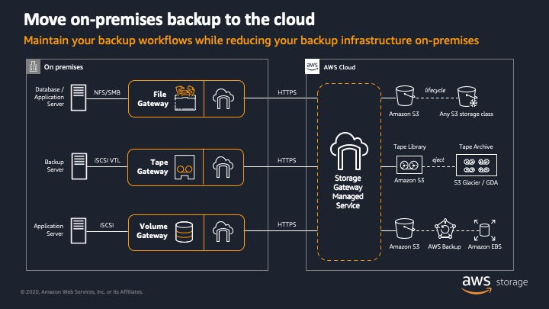

Slide 6
RESULT
Integration and Ecosystem: iCloud is tightly integrated into Apple's ecosystem, offering seamless synchronization and accessibility across Apple devices. This integration is advantageous for users heavily invested in Apple products, as it simplifies data management and accessibility.
Security and Compliance: AWS provides robust security features and compliance certifications, making it suitable for organizations with stringent security and regulatory requirements. AWS allows for extensive customization of security measures and offers a wide range of encryption options.
Scalability and Performance: AWS's infrastructure provides scalability and reliability, ensuring that backup and recovery processes can handle large volumes of data and varying workload demands effectively. This scalability is beneficial for organizations experiencing rapid data growth or fluctuating operational needs.
Cost Efficiency: AWS offers flexible pricing models and cost management tools that allow organizations to optimize their backup and recovery expenditures based on usage. However, iCloud may provide a simpler cost structure for individual users or smaller organizations already within the Apple ecosystem.
In conclusion, the "best" backup and recovery solution depends on factors such as integration with existing systems, security requirements, scalability needs, cost considerations, and user experience preferences. Organizations should evaluate these factors to determine which solution—whether leveraging iCloud, AWS, or a combination thereof—best meets their specific operational and strategic goals.

Slide 7
CONCLUSION
Diverse Needs, Diverse Solutions: The choice between iCloud and AWS for backup and recovery hinges on specific organizational needs and user preferences. iCloud offers seamless integration within Apple's ecosystem, providing convenience and simplicity for users heavily invested in Apple products. On the other hand, AWS excels in scalability, security, and flexibility, making it ideal for organizations with complex data management requirements and stringent security standards.
Security and Compliance: AWS stands out with its robust security features, extensive compliance certifications, and customizable encryption options, making it a preferred choice for organizations prioritizing data security and regulatory compliance. iCloud, while secure within Apple's ecosystem, may not offer the same level of customization and regulatory adherence as AWS.
Scalability and Performance: AWS's scalable infrastructure ensures reliable performance and efficient handling of large volumes of data, catering well to organizations experiencing rapid growth or fluctuating data demands. iCloud's performance and scalability may be more tailored for individual users or smaller-scale operations within the Apple ecosystem.
Cost Considerations: AWS provides flexibility in pricing and cost management tools, allowing organizations to optimize expenditures based on usage. However, iCloud may offer a simpler cost structure and may be more cost-effective for individual users or smaller organizations that primarily use Apple devices and services.

Slide 8

THANK YOU

